Slide 1
PHYS4260 Quantum Mechanics II Spring 2025
Path Integral in QM

Slide 2
Outline
Born Series Recap
The Huygens-Fresnel principle
Path Integral formulation in QM
Two forms for the path integral
Integration over the p variables

Slide 3
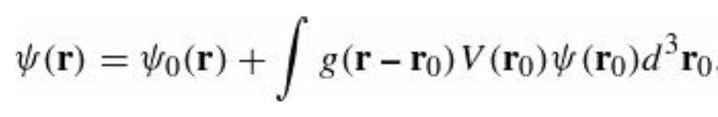
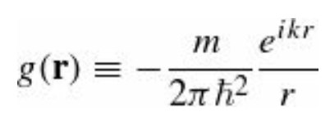
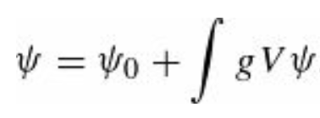
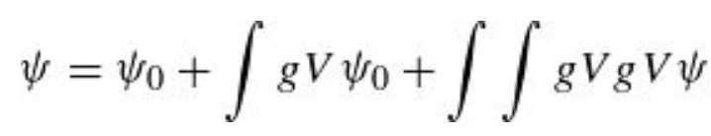
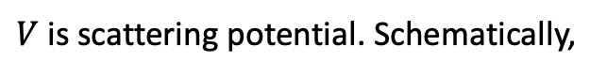
Recap: The Born Series
The integral form of the Schrödinger equation reads
where $ψ_{0}$ represents the incident wave, and the Green’s function (into which we have incorporated the factor $2m/ℏ^{2}$)
$V$ is scattering potential. Schematically,
Suppose we take this expression for $ψ$ and plug it in under the integral sign:

Slide 4
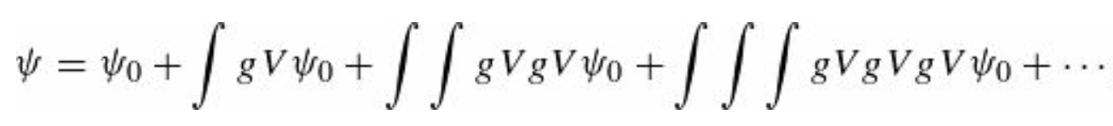
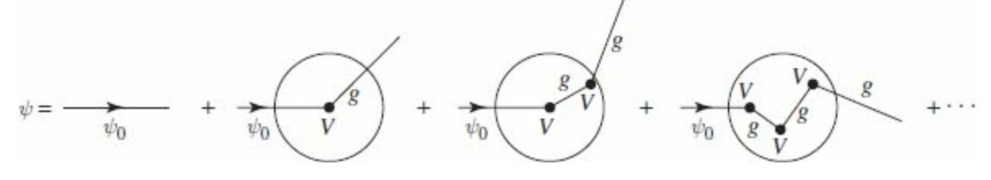
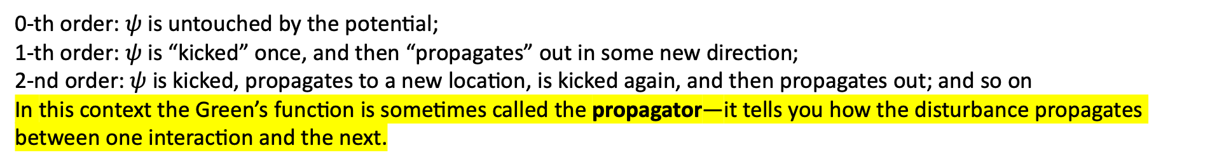
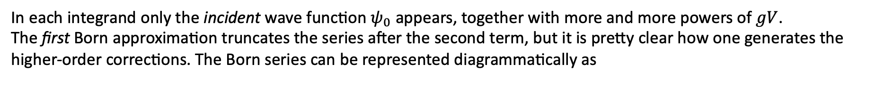
Recap: The Born Series
Iterating this procedure, we obtain a formal series for $ψ$
In each integrand only the incident wave function $ψ_{0}$ appears, together with more and more powers of $gV$.
The first Born approximation truncates the series after the second term, but it is pretty clear how one generates the higher-order corrections. The Born series can be represented diagrammatically as
0-th order: $ψ$is untouched by the potential;
1-th order: $ψ$ is “kicked” once, and then “propagates” out in some new direction;
2-nd order: $ψ$ is kicked, propagates to a new location, is kicked again, and then propagates out; and so on
In this context the Green’s function is sometimes called the propagator—it tells you how the disturbance propagates between one interaction and the next.

Slide 5
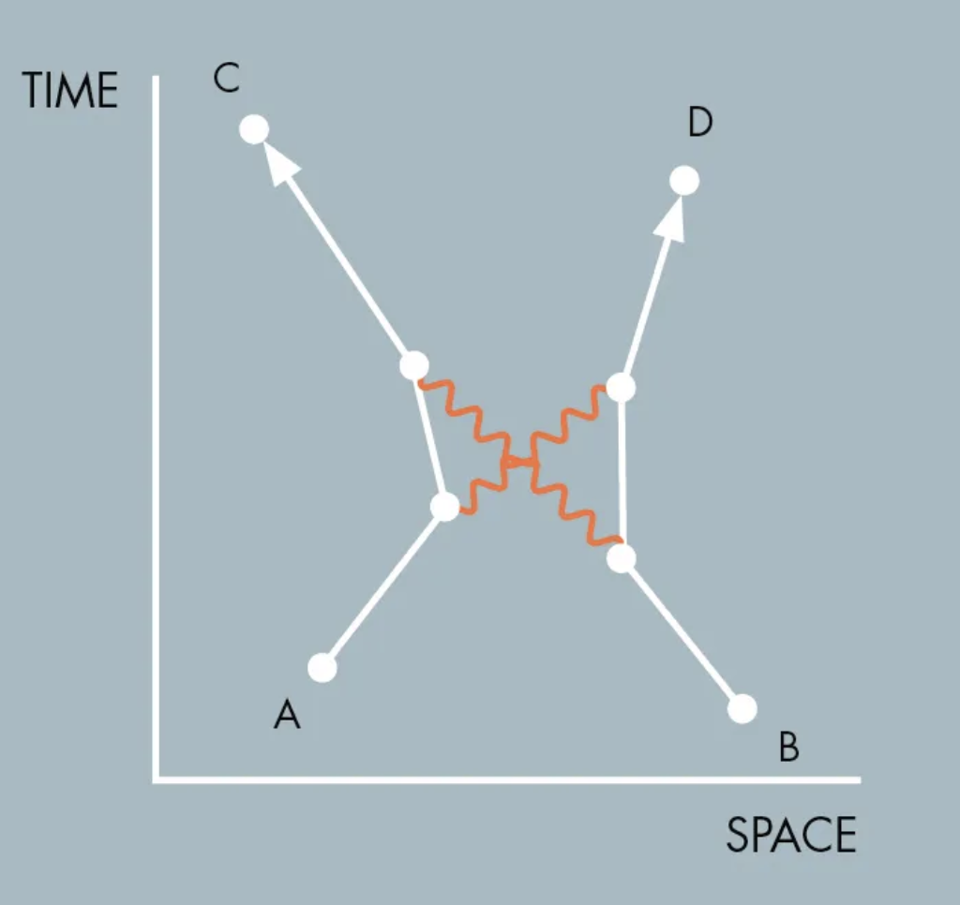
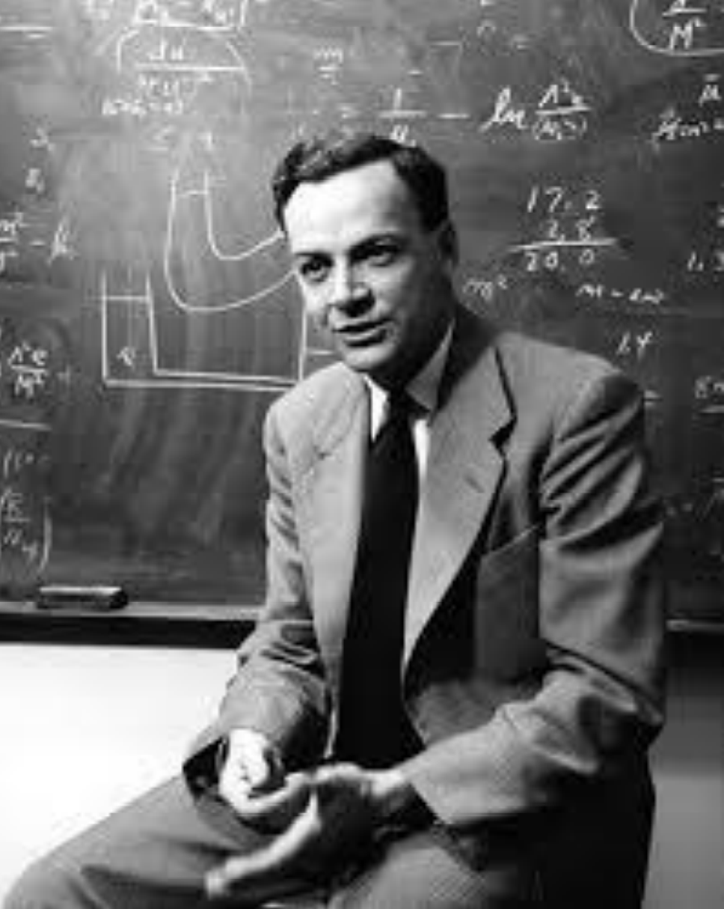
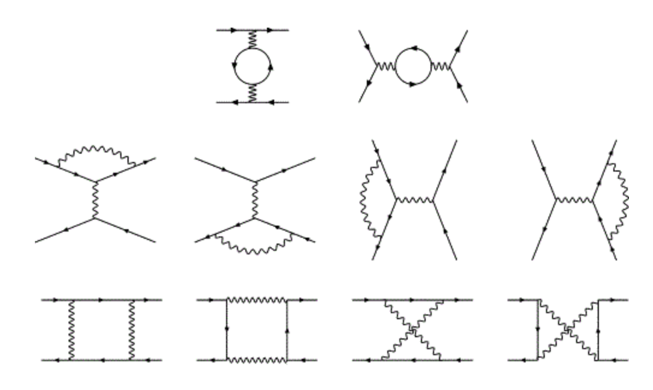
Recap: The Born Series
The Born series was the inspiration for Feynman’s formulation of relativistic quantum mechanics, which is expressed entirely in terms of vertex factors $V$ and propagators $g$ connected together in Feynman diagrams.

Slide 6
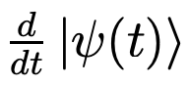
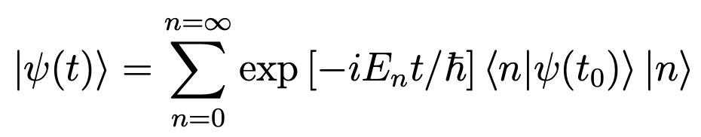
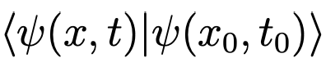
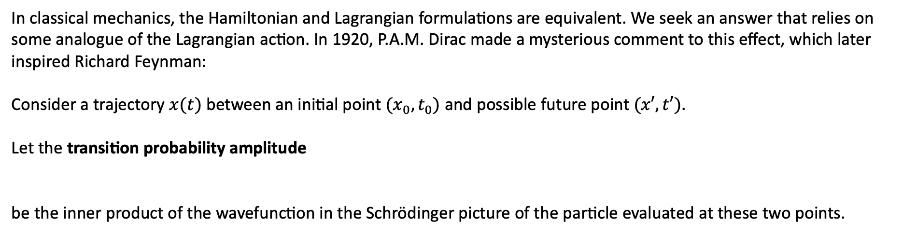
Sum of all stories: The intuitive picture
How does the state of a particle evolve with time?
depends on the system inhabited by the state in the form of the Hamiltonian $\hat{H}$.
After the entire eigen spectrum of $\hat{H}$is known
. That is
In classical mechanics, the Hamiltonian and Lagrangian formulations are equivalent. We seek an answer that relies on some analogue of the Lagrangian action. In 1920, P.A.M. Dirac made a mysterious comment to this effect, which later inspired Richard Feynman:
Consider a trajectory $x(t)$ between an initial point $(x_{0},t_{0})$ and possible future point $(x′, t′)$.
Let the transition probability amplitude
be the inner product of the wavefunction in the Schrödinger picture of the particle evaluated at these two points.

Slide 7
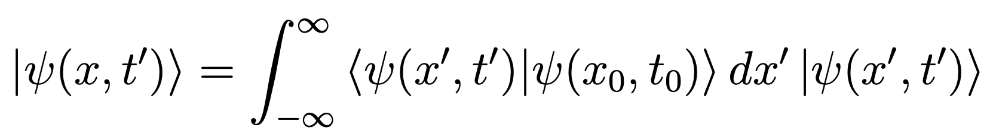
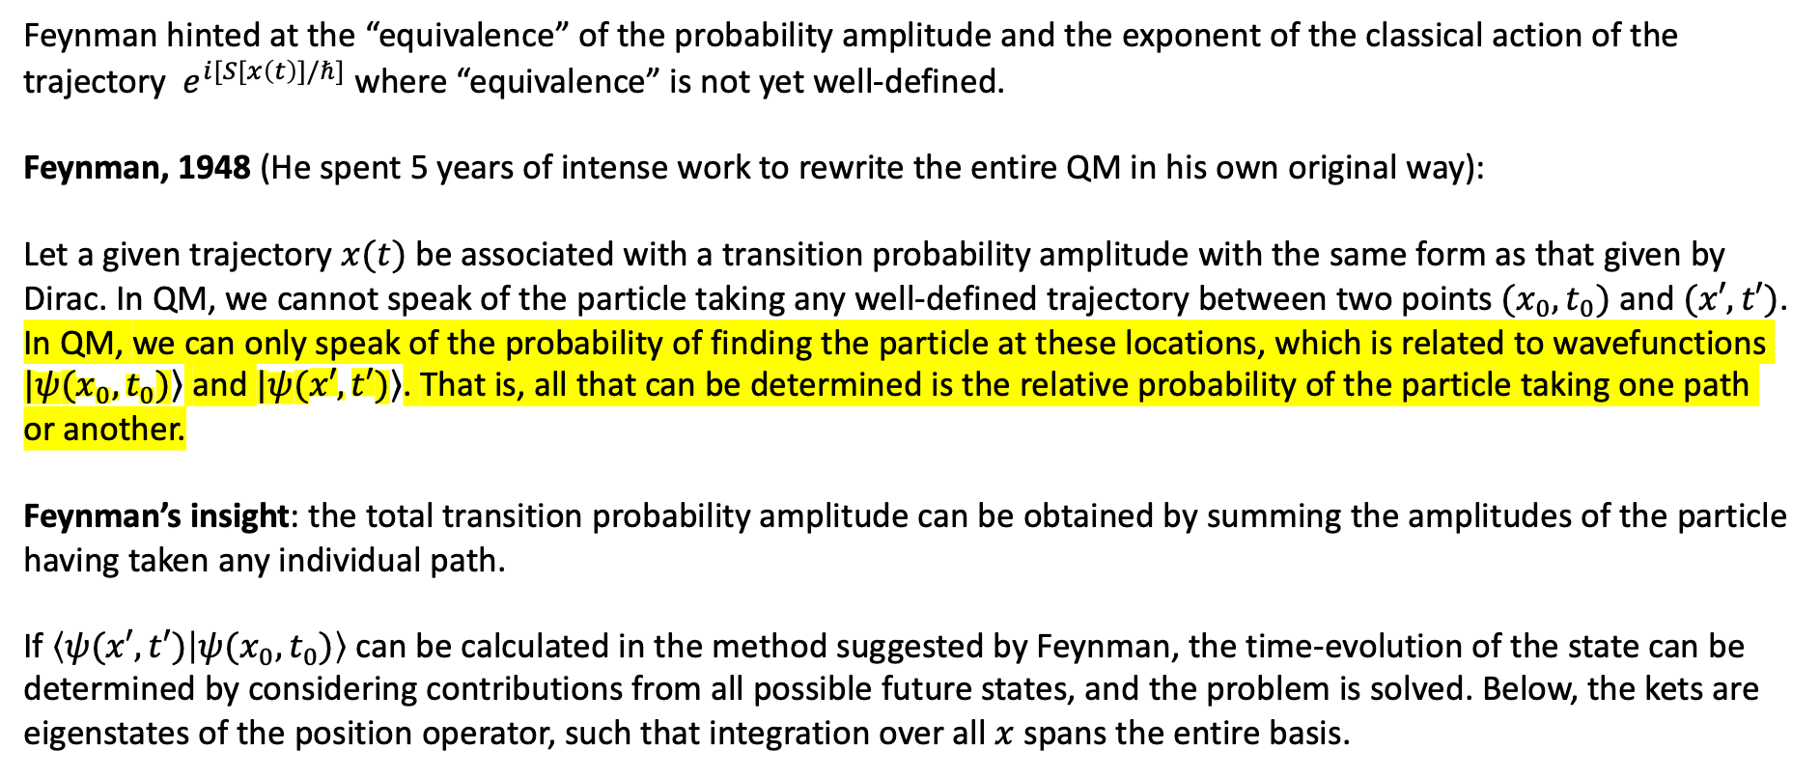
Sum of all stories: The intuitive picture
Feynman hinted at the “equivalence” of the probability amplitude and the exponent of the classical action of the trajectory $e^{i[S[x\left(t\right)]/ℏ]}$ where “equivalence” is not yet well-defined.
Feynman, 1948 (He spent 5 years of intense work to rewrite the entire QM in his own original way):
Let a given trajectory $x(t)$ be associated with a transition probability amplitude with the same form as that given by Dirac. In QM, we cannot speak of the particle taking any well-defined trajectory between two points$(x_{0},t_{0})$ and $(x′, t′)$. In QM, we can only speak of the probability of finding the particle at these locations, which is related to wavefunctions $|\left.ψ(x_{0},t_{0})\right\rangle$ and $|\left.ψ(x′, t′)\right\rangle$. That is, all that can be determined is the relative probability of the particle taking one path or another.
Feynman’s insight: the total transition probability amplitude can be obtained by summing the amplitudes of the particle having taken any individual path.
If $\left\langle ψ(x′, t′) | ψ(x_{0},t_{0})\right\rangle$ can be calculated in the method suggested by Feynman, the time-evolution of the state can be determined by considering contributions from all possible future states, and the problem is solved. Below, the kets are eigenstates of the position operator, such that integration over all $x$ spans the entire basis.

Slide 8
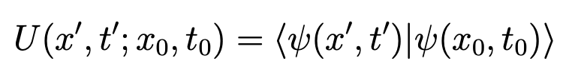
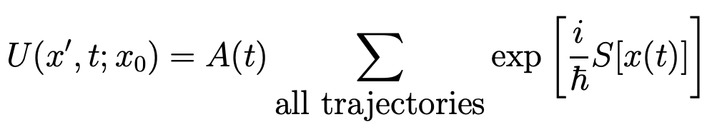
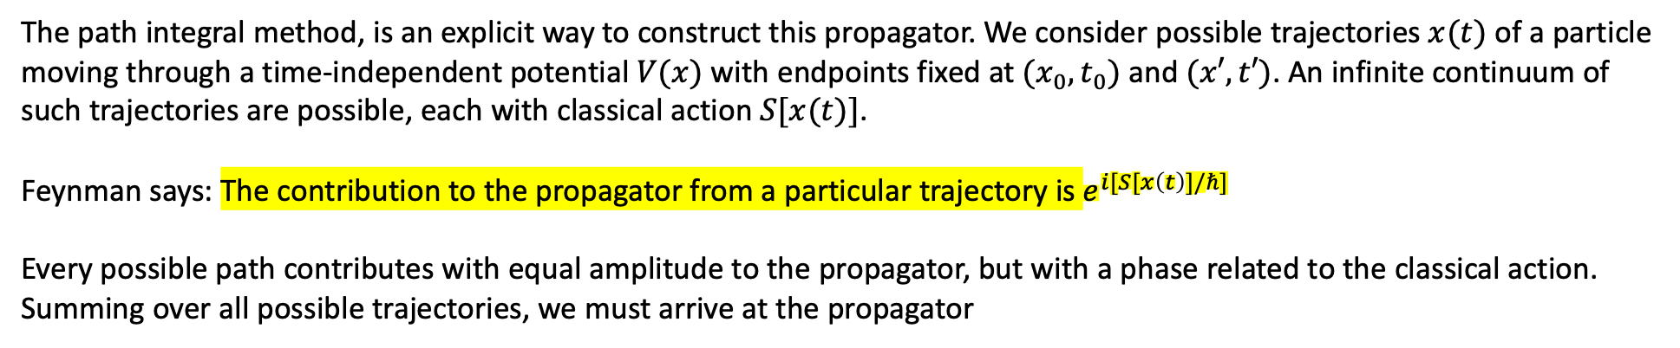
Sum of all stories: The intuitive picture
The propagator of a quantum system between two spacetime points $(x_{0},t_{0})$ and $(x′, t′)$ is the probability transition amplitude between the wavefunction evaluated at those points
The path integral method, is an explicit way to construct this propagator. We consider possible trajectories $x(t)$ of a particle moving through a time-independent potential $V(x)$ with endpoints fixed at $(x_{0},t_{0})$ and $(x′, t′)$. An infinite continuum of such trajectories are possible, each with classical action $S[x(t)]$.
Feynman says: The contribution to the propagator from a particular trajectory is $e^{i[S[x\left(t\right)]/ℏ]}$
Every possible path contributes with equal amplitude to the propagator, but with a phase related to the classical action. Summing over all possible trajectories, we must arrive at the propagator

Slide 9
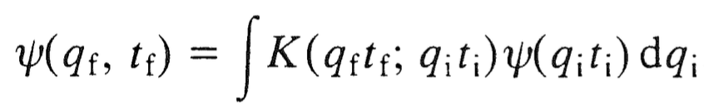
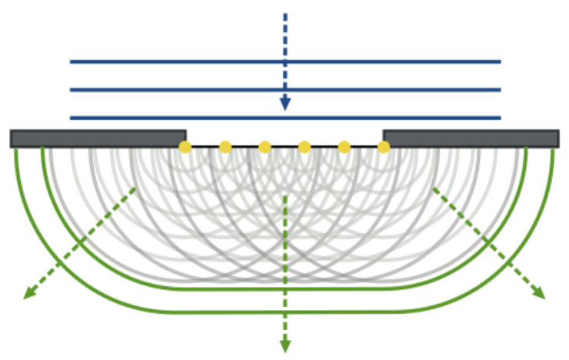
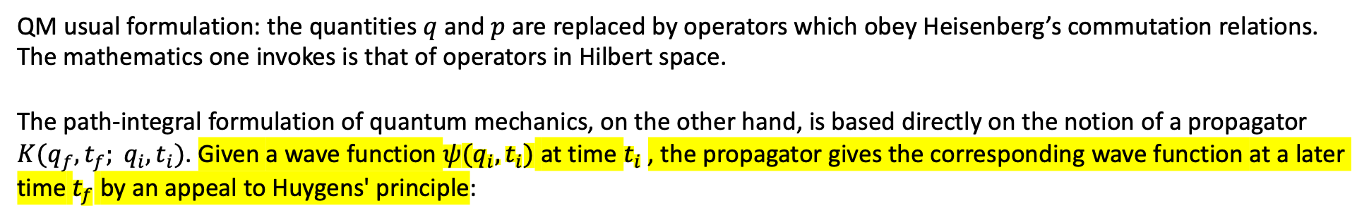
Path Integral in Quantum Mechanics (q, p)
QM usual formulation: the quantities $q$ and $p$ are replaced by operators which obey Heisenberg’s commutation relations. The mathematics one invokes is that of operators in Hilbert space.
The path-integral formulation of quantum mechanics, on the other hand, is based directly on the notion of a propagator $K(q_{f},t_{f}; q_{i},t_{i})$. Given a wave function $ψ(q_{i},t_{i})$ at time $t_{i}$, the propagator gives the corresponding wave function at a later time $t_{f}$ by an appeal to Huygens' principle:
Generalized Huygens Principle
The Huygens–Fresnel principle: Every point on a wavefront is itself the source of spherical wavelets, and the secondary wavelets emanating from different points mutually interfere. The sum of these spherical wavelets forms a new wavefront.
As such, the Huygens-Fresnel principle is a method of analysis applied to problems of luminous wave propagation both in the far-field limit and in near-field diffraction as well as reflection.
Diffraction pattern

Slide 10
Path Integral in Quantum Mechanics
Huygens' theory served as a fundamental explanation of the wave nature of light interference. But did not fully resolve all observations such as the low-intensity double-slit experiment first performed by G. I. Taylor in 1909.
In quantum theory discussions (e.g., the Solvay Conference 1927), Louis de Broglie proposed his hypothesis that the photon is guided by a wave function.
The wave function presents a much different explanation of the observed light and dark bands in a double slit experiment. In this conception, the photon follows a path which is a probabilistic choice of one of many possible paths in the electromagnetic field. These probable paths form the pattern: in dark areas, no photons are landing, and in bright areas, many photons are landing.
The set of possible photon paths is consistent with Richard Feynman's path-integral theory that the paths are determined by the surroundings: the photon's originating point (atom), the slit, and the screen and by tracking and summing phases. The wave function is a solution to this geometry.
The wave function approach was further supported by additional double-slit experiments in Italy and Japan in the 1970s and 1980s with electrons.

Slide 11
Path Integral in Quantum Mechanics
Generalized Huygens' principle from Feynman:
"Actually, Huygens’ principle is not correct in optics. It is replaced by Kirchoff’s modification which requires that both the amplitude and its derivative must be known on the adjacent surface. This is a consequence of the fact that the wave equation in optics is second order in the time. The wave equation of quantum mechanics is first order in the time; therefore, Huygens’ principle is correct for matter waves, action replacing time."
Kirchhoff provided a rigorous mathematical formulation of Huygens’ principle which postulates that any point on a wave front behaves like a point-like source that emits a spherical wave moving at the speed of light.
Then, the field at a given point and at a later time is a superposition of all fields emerging from these sources.
The envelope of all these waves forms the next wave front. Kirchhoff’s formula serves, e.g., as the starting point for the discussion of problems related to optical diffraction.

Slide 12
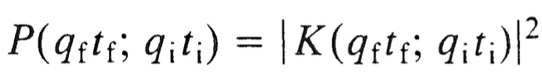
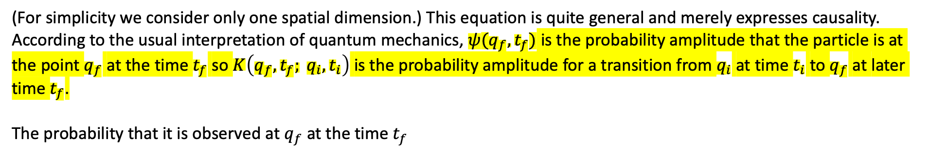
Path Integral in Quantum Mechanics
(For simplicity we consider only one spatial dimension.) This equation is quite general and merely expresses causality. According to the usual interpretation of quantum mechanics, $ψ(q_{f},t_{f})$ is the probability amplitude that the particle is at the point $q_{f}$ at the time $t_{f}$ so $K\left(q_{f},t_{f}; q_{i},t_{i}\right)$ is the probability amplitude for a transition from $q_{i}$ at time $t_{i}$ to $q_{f}$ at later time $t_{f}$.
The probability that it is observed at $q_{f}$ at the time $t_{f}$
This is a fundamental principle of quantum mechanics.

Slide 13
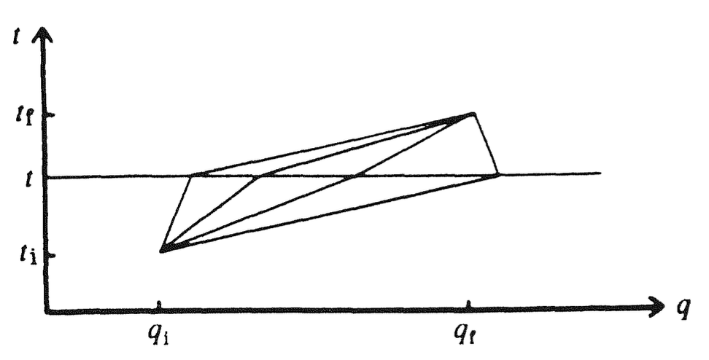
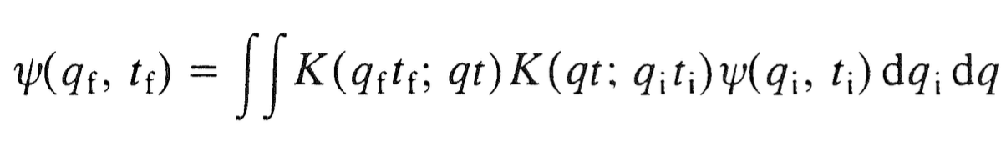
Path Integral in Quantum Mechanics
Let us divide the time interval between $t_{i}$ to $t_{f}$ into two, with $t$ as the intermediate time, and $q$ the intermediate point in space.
Repeated application of the previous expression gives

Slide 14
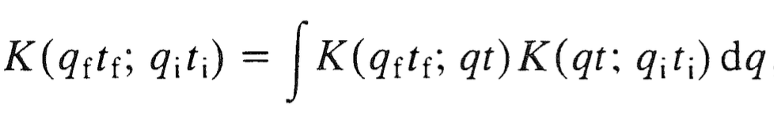
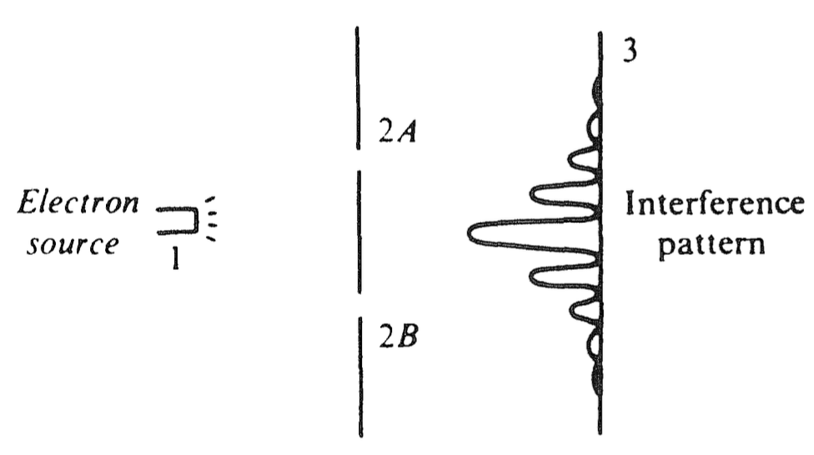
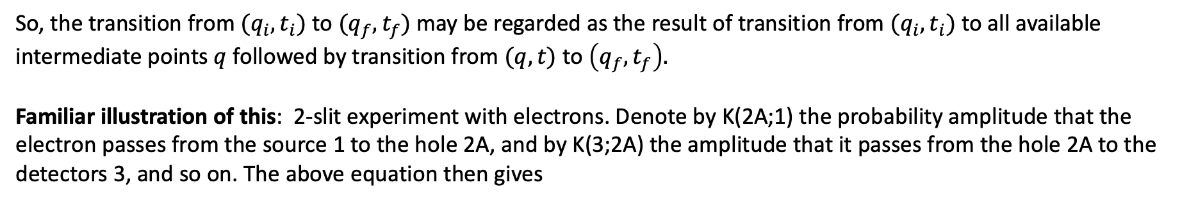
Path Integral in Quantum Mechanics
From the previous expression it follows that
So, the transition from $(q_{i},t_{i})$ to $(q_{f},t_{f})$may be regarded as the result of transition from $(q_{i},t_{i})$ to all available intermediate points $q$ followed by transition from $(q, t)$ to $\left(q_{f},t_{f}\right).$
Familiar illustration of this: 2-slit experiment with electrons. Denote by K(2A;1) the probability amplitude that the electron passes from the source 1 to the hole 2A, and by K(3;2A) the amplitude that it passes from the hole 2A to the detectors 3, and so on. The above equation then gives

Slide 15
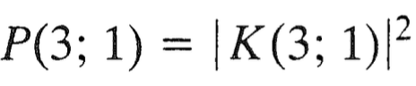
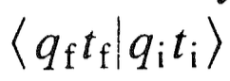
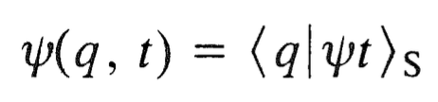
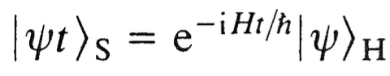
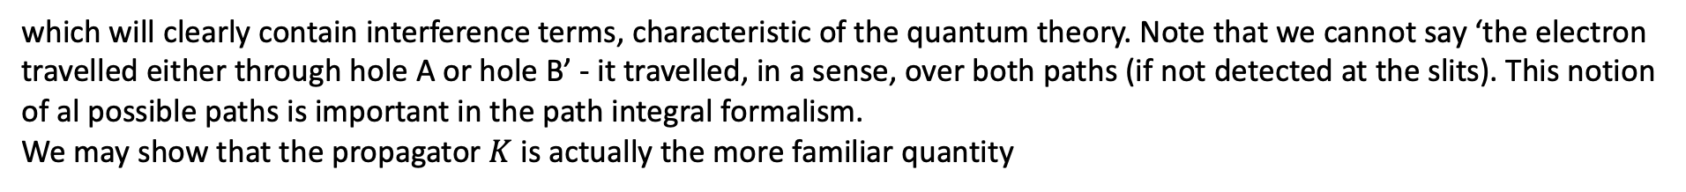
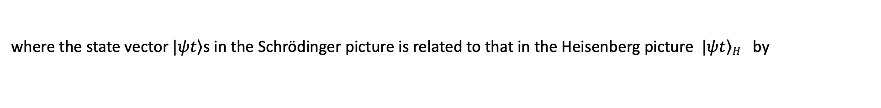
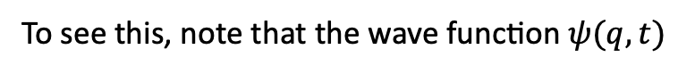
Path Integral in Quantum Mechanics
The intensity pattern of the 'screen’ 3 is given by the probability
which will clearly contain interference terms, characteristic of the quantum theory. Note that we cannot say ‘the electron travelled either through hole A or hole B’ - it travelled, in a sense, over both paths (if not detected at the slits). This notion of al possible paths is important in the path integral formalism.
We may show that the propagator $K$ is actually the more familiar quantity
To see this, note that the wave function $ψ(q,t)$
where the state vector $\left.|ψt\right\rangle$s in the Schrödinger picture is related to that in the Heisenberg picture $\left.|ψt\right\rangle H$ by

Slide 16
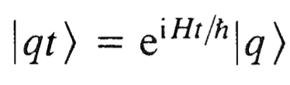
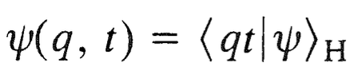
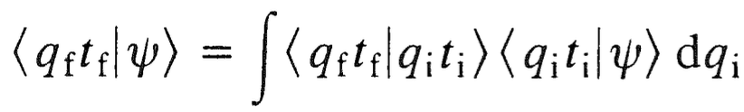
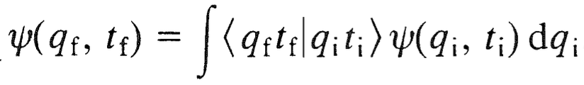
Path Integral in Quantum Mechanics
Let us define the vector
which we may call, for obvious reasons, a 'moving frame'. We then have
Completeness of states enables us to write
which can be rewritten as

Slide 17
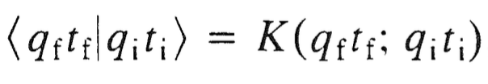
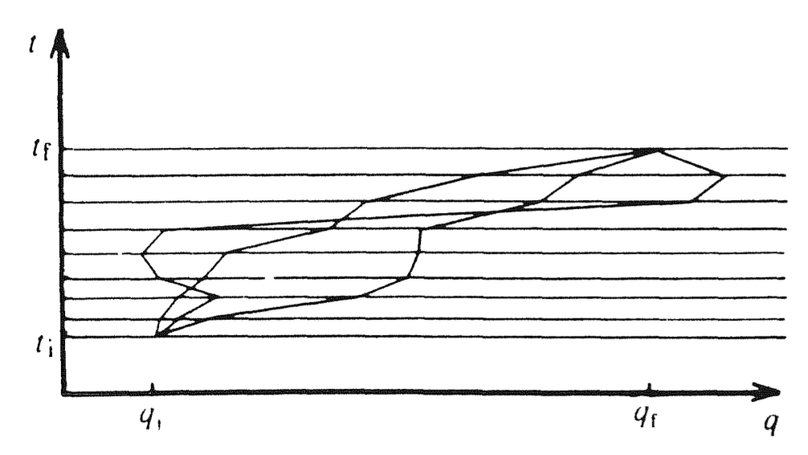
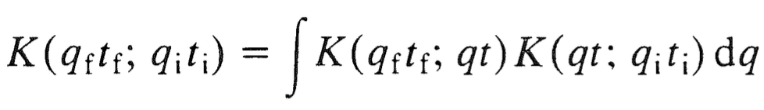
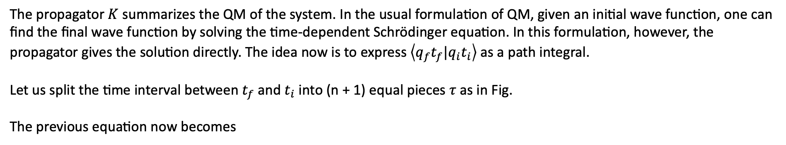
Path Integral in Quantum Mechanics
By comparison we note that
The propagator $K$ summarizes the QM of the system. In the usual formulation of QM, given an initial wave function, one can find the final wave function by solving the time-dependent Schrödinger equation. In this formulation, however, the propagator gives the solution directly. The idea now is to express $\left\langle q_{f}t_{f}|q_{i}t_{i}\right\rangle$as a path integral.
Let us split the time interval between $t_{f}$ and $t_{i}$ into (n + 1) equal pieces $τ$ as in Fig.
The previous equation now becomes
The integral is taken over all possible 'trajectories'

Slide 18
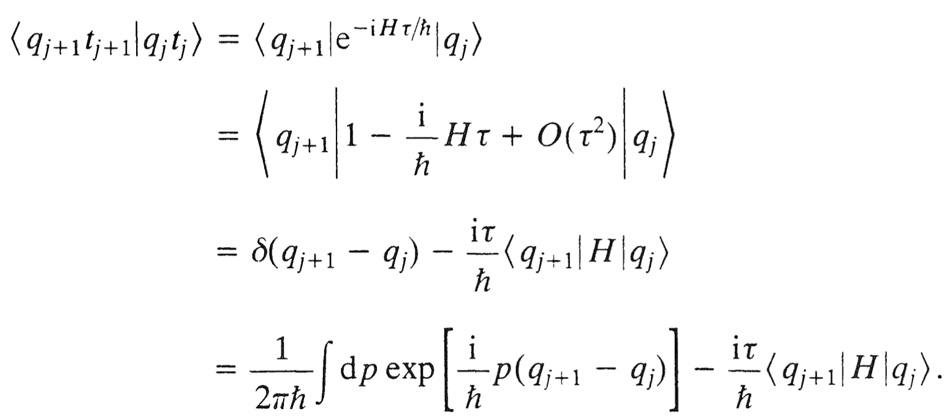
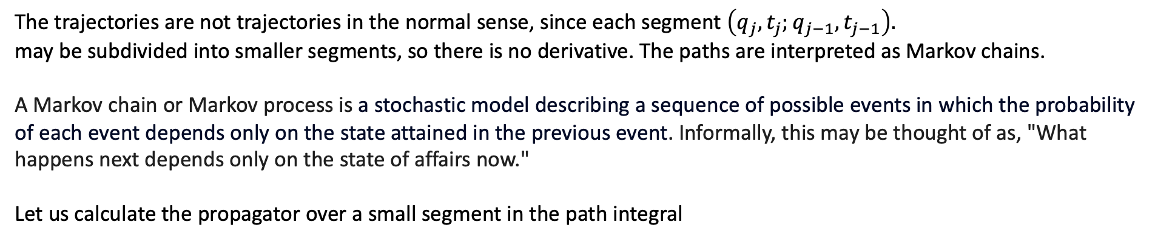
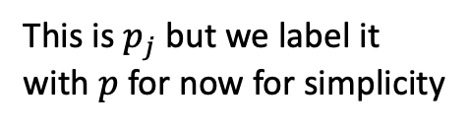
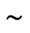
Path Integral in Quantum Mechanics
The trajectories are not trajectories in the normal sense, since each segment $\left(q_{j},t_{j};q_{j−1},t_{j−1}\right).$
may be subdivided into smaller segments, so there is no derivative. The paths are interpreted as Markov chains.
A Markov chain or Markov process is a stochastic model describing a sequence of possible events in which the probability of each event depends only on the state attained in the previous event. Informally, this may be thought of as, "What happens next depends only on the state of affairs now."
Let us calculate the propagator over a small segment in the path integral
we rewrite the Dirac delta in terms
of its integral representation
This is $p_{j}$ but we label it
with $p$ for now for simplicity
$$\sim$$

Slide 19



Path Integral in Quantum Mechanics
The Hamiltonian $H$ is a function of the operators $p$ and $q$. In the special case where $H$ is of the form
(actually, $H$ can be any function of $p$plus any function of $q$), the matrix element in the previous eqn. may easily be calculated. We have
Where we used twice, and substituting
(*)
(*) This is from NR QM where a one-particle state of momentum $p$ in the coordinate representation is given by a plane wave: $ψ_{p}\left(x\right)=C e^{ip∙x}$

Slide 20


Path Integral in Quantum Mechanics
we obtain
where we removed the p’ integration with the Dirac delta.
$p^{2}$ on the left-hand side of the equation is an operator, whereas on the right-hand side it is a number. We could have used
a notation such as $\hat{p}$ to call attention to the operator nature of $p$ on the left-hand side. But in any case, it is an important
result that the formula we have on the right contains no operators.

Slide 21


Path Integral in Quantum Mechanics
In a similar fashion, the contribution from the potential is given as
where the potential function $V(q)$ is evaluated in $\overline{q}$ defined as the average
and the expression on the left is an operator expression. But again, the integral on the right contains no operators.

Slide 22




Path Integral in Quantum Mechanics
Putting these two expressions together, we have
And using the previous result
we obtain
where $p_{j}$ is the momentum between $t_{j}$ and $t_{j+1}$ or, equivalently, $q_{j}$ and $q_{j+1}$.
This gives the propagator over a segment of one possible path.

Slide 23

Path Integral in Quantum Mechanics
Figure: Segments of the trajectory in momentum space.
The full propagator is obtained by substituting the expression for into
and performing the continuum limit, where $p_{j}$ is the momentum between $q_{j}$ and $q_{j+1}$.
)

Slide 24


Path Integral in Quantum Mechanics
The previous integral can formally be written as
with

Slide 25



Path Integral in Quantum Mechanics
$$)$$
this integral can formally be written as
where $τ→dt$ when $n→∞$ and
In the continuum limit $q$ becomes a function of $t$, and the integral is a ``functional integral’’, an integral over all functions.
It is infinite-dimensional.
Represents the path integral expression for the transition amplitude from ${(q}_{i},t_{i})$ to ${(q}_{f},t_{f})$.
Each function $q(t)$ and $p(t)$ defines a path in phase space.

Slide 26


Schrödinger equation paradigm
The more usual approach to quantum mechanics is to solve the Schrödinger equation
where $\hat{H}$ is an operator, subject to some boundary conditions.
In the path-integral formulation we have an explicit expression for the transition amplitude, which is clearly very well suited to scattering problems.
The quantities $p$ and $q$ occurring in the integral are classical quantities, not operators (c-numbers, not q-numbers).
In Feynman's path integral, the classical notion of a unique trajectory for a particle is replaced by an infinite sum of classical paths, each weighted differently according to its classical properties.
It is not obvious, however, that infinite-dimensional integrals of this type are well-defined mathematically, that is, whether they converge; in other words, exist! We shall assume that they do.

Slide 27



$p_{j}$-integration
Using the full expression for the Hamiltonian
we arrive at another form for the transition amplitude which holds when $H$ is of this form, since in this case we can
perform the $p$-integration.
The $p_{j}$ integration is performed using the Gaussian integral

Slide 28




$p_{j}$-integration
and doing the integration over $p_{j}$ one arrives at
and hence, in the continuum limit, one obtains
(*)
where $L = T− V$, is the classical Lagrangian. In the limit $n→∞$ , $N$ becomes infinite, but this does not matter, since we
shall always deal with normalized transition amplitudes.
The integrand is the classical action $S = \int{Ldt}$. We have proved this equation from the postulates of quantum mechanics, and by assuming that the Hamiltonian is of the form $H=T+V$.
Feynman's original approach was to adopt (*) as a hypothesis and then prove the Schrödinger equation from it.
The disadvantage of this approach is that (*) does not hold in general, since $H$ is not always $H=p^{2}/2m$ $+ V$.

Slide 29







$p_{j}$-integration
In fact, we can provide the following counter example. If
which describes a system with a velocity-dependent potential, then the momentum is
and the Hamiltonian is
which is not of the form $H=p^{2}/2m$ $+ V$. Substituting this into
And performing the p-integrations, we arrive at
where we obtained an effective action
which differs from $S = \int{Ldt}$.

